Slide 1
影像處理、電腦視覺及深度學習概論 (Introduction to Image Processing, Computer Vision and Deep Learning) Homework 2
TA: 張議隆
Gmail: nckubot65904@gmail.com
Office Hour: 14:00~16:00, Mon.
10:00~12:00, Fri.
At CSIE 9F Robotics Lab.

Slide 2
Notice (1/2)
Copying homework is strictly prohibited!! Penalty: Both individuals will receive a score of 0!!
Due date => 09:00:00, 2023/12/19 (Tue.)
Do not submit late, or the following points will be deducted:
Submit within seven days after the deadline, and your score will be reduced by half.
If you submit after this period, you will receive a score of 0.
You must attend the demonstration, otherwise your score will be 0. The demonstration schedule will be announced on NCKU Moodle.
You must create GUI, otherwise your point will be deducted.
Upload to => 140.116.154.28 -> Upload/Homework/Hw2
User ID: opencvdl2023 Password: RL2023opencv
Format
Filename: Hw2_StudentID_Name_Version.rar
Ex: Hw2_F71234567_林小明_V1.rar
If you want to update your file, you should update your version to be V2,
Ex: Hw2_F71234567_林小明_V2.rar
Content: Project folder *( Excluding the pictures ) *Note: Remove your “Debug” folder to reduce file size.

Slide 3
Notice (2/2)
Python (recommended):
Python 3.8 (https://www.python.org/downloads/)
Opencv-contrib-python (3.4.2.17)
Matplotlib 3.7.3
UI framework: pyqt5 (5.15.10)
Pytorch 2.1.0
Torchvision 0.16.0
Torchsummary 1.5.1
Tensorboard 2.14.0
Pillow 10.1.0

Slide 4

Assignment scoring (Total: 100%)
(出題： You)
1. (20%) Hough Circle Transform
1.1 (15%) Draw Contour
1.2 (5%) Count Rings
2. (20%) Histogram Equalization
3. (20%) Morphology Operation
3.1 (10%) Closing
3.2 (10%) Opening
4. (20%) Training a MNIST Classifier Using VGG19 with BN
4.1 (6%) Load Model and Show Model Structure.
4.2 (6%) Show Training/Validating Accuracy and Loss.
4.3 (8%) Use the Model with Highest Validation Accuracy to Run Inference, Show the Predicted Distribution and Class Label.
5. (20%) Train a Cat-Dog Classifier Using ResNet50
5.1 (5%) Load the dataset and resize images
5.2 (5%) Show the structure of ResNet50 model
5.3 (5%) Improve ResNet50 with Random-Erasing and Compare the accuracies of 2 ResNet50 models on validation dataset
5.4 (5%) Use the trained model to run inference and show the predicted class label
* Don’t fix your image path
(There is another dataset for demonstration)
Load image 請用下面Function 來讀取路徑
QFileDialog.getOpenFileName
獲取打開的檔路徑
(出題：Eric)
(出題：Hsiang)
(出題：Shang)
(出題：Shan)

Slide 5
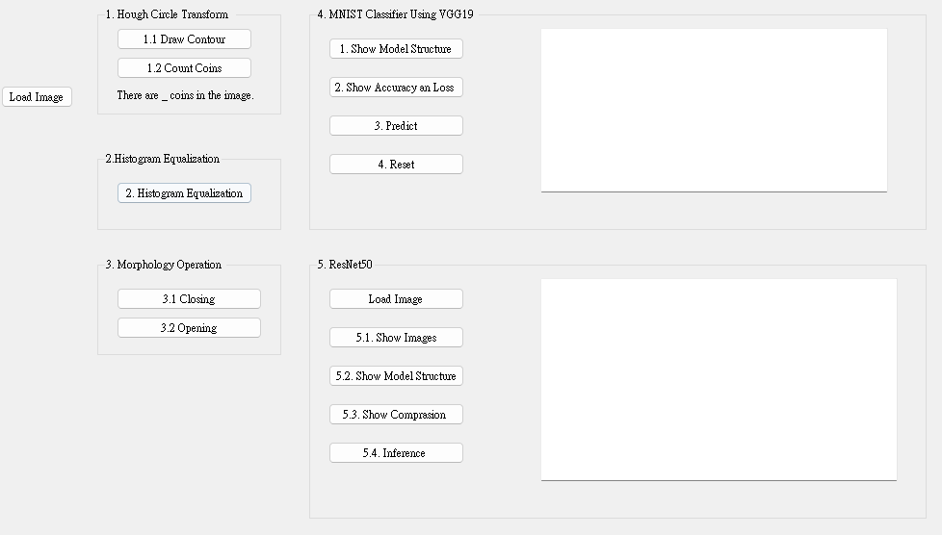
Assignment scoring (Total: 100%)
Use one UI to present 5 questions.

Slide 6
1. (20%) Hough Circle Transform
(出題：You)
1.1 (15%) Draw Contour
1.2 (5%) Count Rings

Slide 7
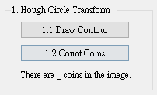
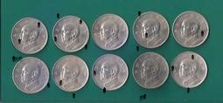
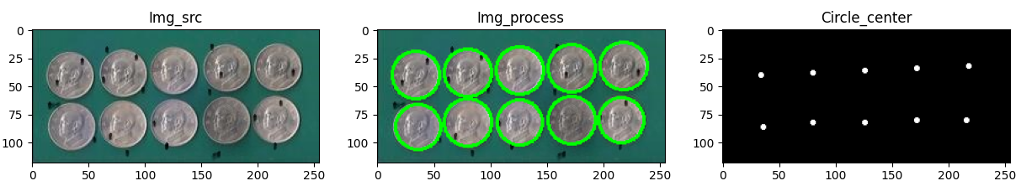
1.1 Hough Circle Transform – Draw Contour
(出題：You)
Given: One color image, “coins.jpg”
Q:
Hint: Textbook Chapter 6, p.153 ~ p.161
RGB ➔ Grayscale
Remember to remove the noise. (Use cv2.GaussianBlur(5, 5))
Using circle detection function to get result.
(Use cv2.HoughCircles)
4. Display the original image, processed image, and circle center image at the same time.
1) Draw Contour: Using OpenCV functions to find the contours of coins in image.
2) Circle Center: Show center points of the circle with most votes.
coins.jpg: 255x118
Draw Contours

Slide 8
1.2 Hough Circle Transform – Count Coins
(出題：You)
Given: One color image, “coins.jpg”
Q: 3)
Hint: Textbook Chapter 6, p.153 ~ p.161
Calculate how many coins and show on your UI.
Count coins: Using OpenCV functions to find how many coins in the image.
Calculate
coins.jpg: 255x118

Slide 9
2. (20%) Histogram Equalization
(出題： Eric)
Given: A single grayscale image will be provided as input.
Q: Perform histogram equalization on a grayscale image to enhance its contrast using OpenCV and manual(PDF&CDF).
Part 1: Using OpenCV
Load histoEqual.png (click “Load Image” button).
Hint: your_image_path = filedialog.askopenfilename()
Perform histogram equalization using cv2.equalizeHist() function from OpenCV to process image.
The equalized image will be displayed alongside the original image for comparison in the upper quadrants.
The histograms of both the original and the equalized images will be shown in the lower quadrants.
Hint: using plt.bar() to display the frequency (y-axis) of each grayscale value (x-axis).
Part 2: Using PDF and CDF (tutorial)
The Probability Density Function (PDF) represents the frequency of each grayscale level in the image.
The Cumulative Distribution Function (CDF) is the cumulative sum of the PDF and is used to map the old grayscale values to new ones.
The program calculates the histogram of the grayscale image using numpy.histogram().
The PDF is obtained from the normalized histogram.
The CDF is calculated by cumulatively summing the PDF.
A lookup table is created based on the rounded CDF values, it is applied to the original image to create a new equalized image.
The histogram of the manually equalized image is also plotted, showing the redistributed grayscale frequencies.
Click “2. Histogram Equalization” button to show result.

Slide 10
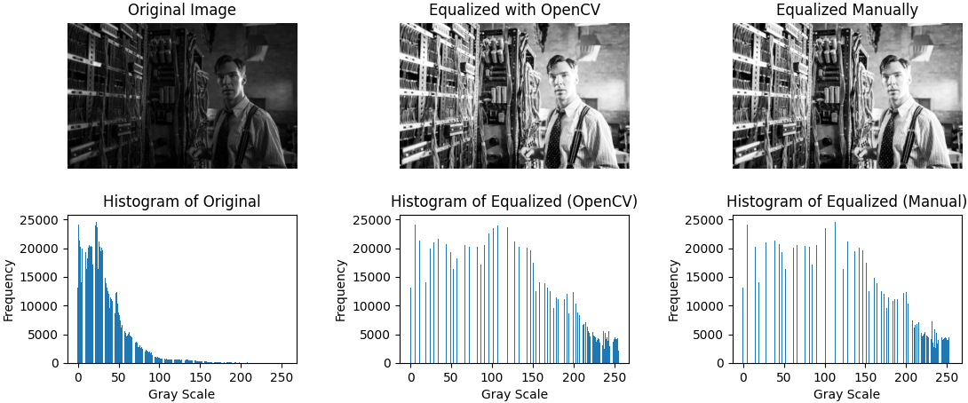
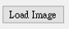
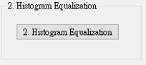
2. (20%) Histogram Equalization
(出題： Eric)
Result:
GUI:

Slide 11
3. Morphology Operation (20%)
(出題：Hsiang)
3.1 (10%) Closing
3.2 (10%) Opening

Slide 12
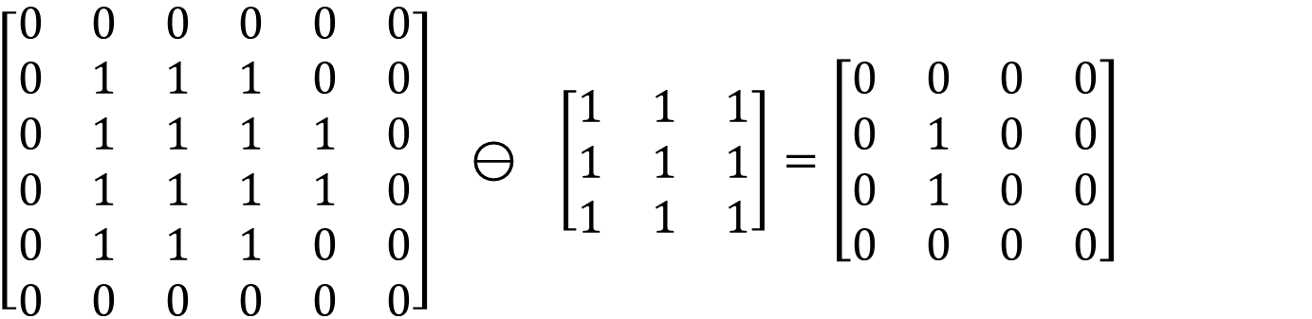
3. Morphology Operation (1/3)
(出題：Hsiang)
Steps of Erosion Operation:
Define Structuring Element Choose a structuring element, typically a small square or rectangular convolution kernel. The size and shape of this element determine the effect of the erosion.
Scanning Initiate the process by sliding the structuring element from the top-left corner of the image. Sequentially cover each pixel in the image, moving both horizontally from left to right and vertically from top to bottom.
Pixel Update For each covered region, update the pixel values covered by the structuring element to the minimum pixel value in that region.
The minimum pixel value in red region is 0.
$\left[\begin{matrix}0 & 0 & 0 & 0 & 0 & 0 \\ 0 & 1 & 1 & 1 & 0 & 0 \\ 0 & 1 & 1 & 1 & 1 & 0 \\ 0 & 1 & 1 & 1 & 1 & 0 \\ 0 & 1 & 1 & 1 & 0 & 0 \\ 0 & 0 & 0 & 0 & 0 & 0\end{matrix}\right] ⊖ \left[\begin{matrix}1 & 1 & 1 \\ 1 & 1 & 1 \\ 1 & 1 & 1\end{matrix}\right]=\left[\begin{matrix}0 & 0 & 0 & 0 \\ 0 & 1 & 0 & 0 \\ 0 & 1 & 0 & 0 \\ 0 & 0 & 0 & 0\end{matrix}\right]$
Structuring Element
Output
The minimum pixel value in blue region is 1.
Input

Slide 13
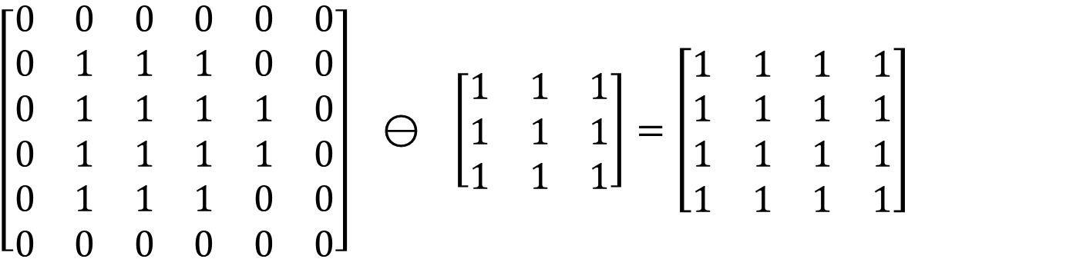
3. Morphology Operation (2/3)
(出題：Hsiang)
Steps of Dilation Operation:
Define Structuring Element Choose a structuring element, typically a small square or rectangular convolution kernel. The size and shape of this element determine the effect of the erosion.
Scanning Initiate the process by sliding the structuring element from the top-left corner of the image. Sequentially cover each pixel in the image, moving both horizontally from left to right and vertically from top to bottom.
Pixel Update For each covered region, update the pixel values covered by the structuring element to the maximum pixel value in that region.
The maximum pixel value in red region is 1.
$\left[\begin{matrix}0 & 0 & 0 & 0 & 0 & 0 \\ 0 & 1 & 1 & 1 & 0 & 0 \\ 0 & 1 & 1 & 1 & 1 & 0 \\ 0 & 1 & 1 & 1 & 1 & 0 \\ 0 & 1 & 1 & 1 & 0 & 0 \\ 0 & 0 & 0 & 0 & 0 & 0\end{matrix}\right] ⊖ \left[\begin{matrix}1 & 1 & 1 \\ 1 & 1 & 1 \\ 1 & 1 & 1\end{matrix}\right]=\left[\begin{matrix}1 & 1 & 1 & 1 \\ 1 & 1 & 1 & 1 \\ 1 & 1 & 1 & 1 \\ 1 & 1 & 1 & 1\end{matrix}\right]$
Structuring Element
Output
Input
The maximum pixel value in blue region is 1.

Slide 14
3. Morphology Operation (3/3)
(出題：Hsiang)
Closing Operation：
An operation performed by first applying dilation followed by erosion：Closing(A) = Erosion(Dilation(A))
The purpose is to fill small holes in an image while preserving the shape and size of large holes and objects in the image.
Opening Operation：
An operation performed by first applying erosion followed by dilation ：Opening(A) = Dilation (Erosion(A))
The purpose is to remove small objects and thin lines from an image while preserving the shape and size of larger objects in the image

Slide 15
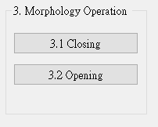


3.1 Closing (10%)
(出題：Hsiang)
Given: “closing.png”
Constraint: Can not use OpenCV Function cv2.dilate(), cv2.erosion(), cv2.morphologyEx()
Question: Perform opening operation on the image
Using “Load image” button to load RGB image.
Convert the RGB image to grayscale.
Binarize the grayscale image, assigning values of 0 or 255 only. (threshold = 127)
Pad the image with zeros based on the kernel size (K=3).
Perform the dilation operation using a 3x3 all-ones structuring element.
Perform the erosion operation using a 3x3 all-ones structuring element.
Show the image in a popup window.
Closing Operation

Slide 16


3.1 Opening (10%)
(出題：Hsiang)
Given: “opening.png”
Constraint: Can not use OpenCV Function cv2.dilate(), cv2.erosion(), cv2.morphologyEx()
Question: Perform opening operation on the image
Using “Load image” button to load RGB image.
Convert the RGB image to grayscale.
Binarize the grayscale image, assigning values of 0 or 255 only. (threshold = 127)
Pad the image with zeros based on the kernel size (K=3).
Perform the erosion operation using a 3x3 all-ones structuring element.
Perform the dilation operation using a 3x3 all-ones structuring element.
Show the image in a popup window.
Opening Operation

Slide 17
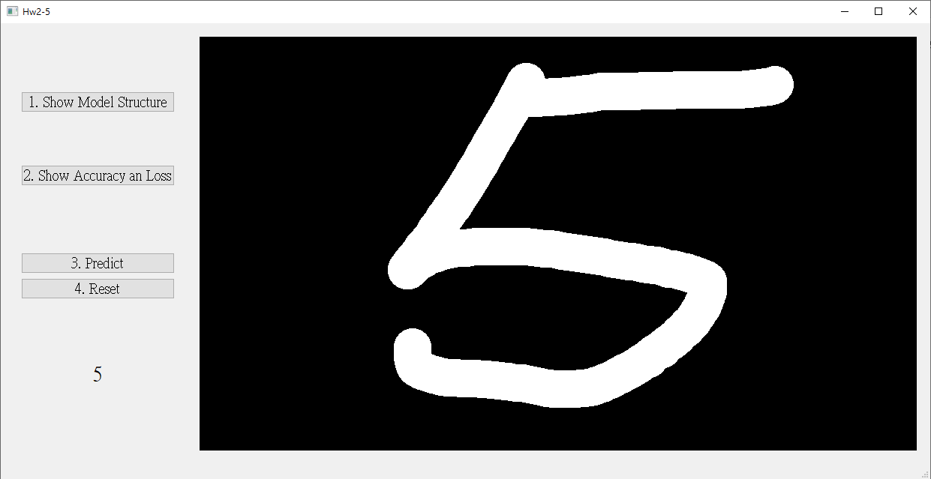
4. Training a MNIST Classifier Using VGG19 with BN (20%)
(出題：Shang)
4.1 Load Model and Show Model Structure. (6%)
4.2 Show Training/Validating Accuracy and Loss. (6%)
4.3 Use the Model with Highest Validation Accuracy to Run Inference, Show the Predicted Distribution and Class Label. (8%)
Figure: GUI example

Slide 18
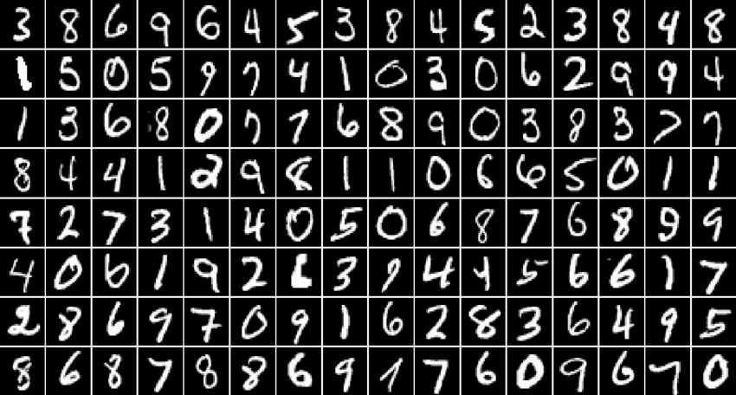
4.0 Training a MNIST Classifier Using VGG19 with BN (20%)
Requirement
Train VGG19 model with batch normalization (BN) using PyTorch.
Download dataset using torchvision.datasets.MNIST() (tutorial)
Training data: 60000 images
Validation data: 10000 images
Resize image to (32, 32)
Parameters
At least 30 epochs.
Cross entropy loss
Adam optimizer
Record training/validation loss and accuracy in .jpg or .png format.
In the submitted file, you need to include
Weight file for VGG19 with BN in .pth format. (File size is approximately 540MB)
Figure of training/validating loss and accuracy in .jpg or .png format.
Code for your GUI program
Code for model training.
Please do not include image data in the submitted file.
(出題：Shang)
R. Reference
VGG19
Batch Normalization

Slide 19
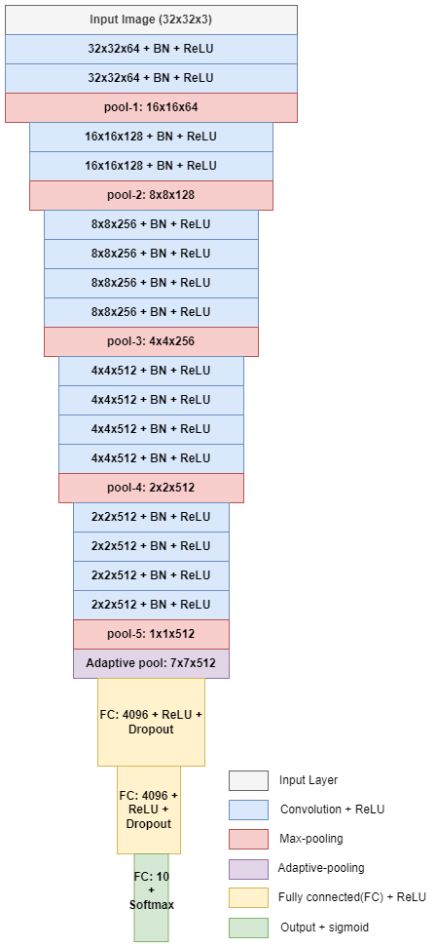
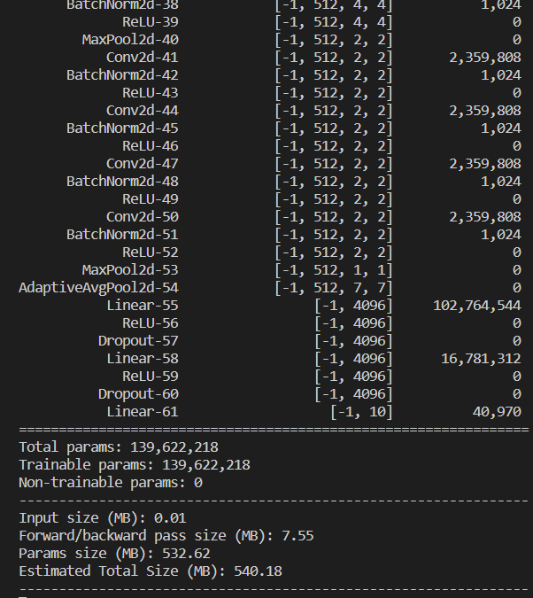
4.1 Show the Structure of VGG19 with BN (6%)
Click the button “1. Show Model Structure”
Show the VGG19 with BN model on terminal using torchsummary.summary().
(出題：Shang)
The -1 indicates that the actual size of batch size can vary.
Feature map shape
(Batch, Channels,
Height, Width)
Layer (type)
Num. of param.
All convolution filter size is 3x3
1. Click the button.
Flatten Here
Figure: the Structure of VGG19 with BN
Figure: VGG19 with BN model structure

Slide 20
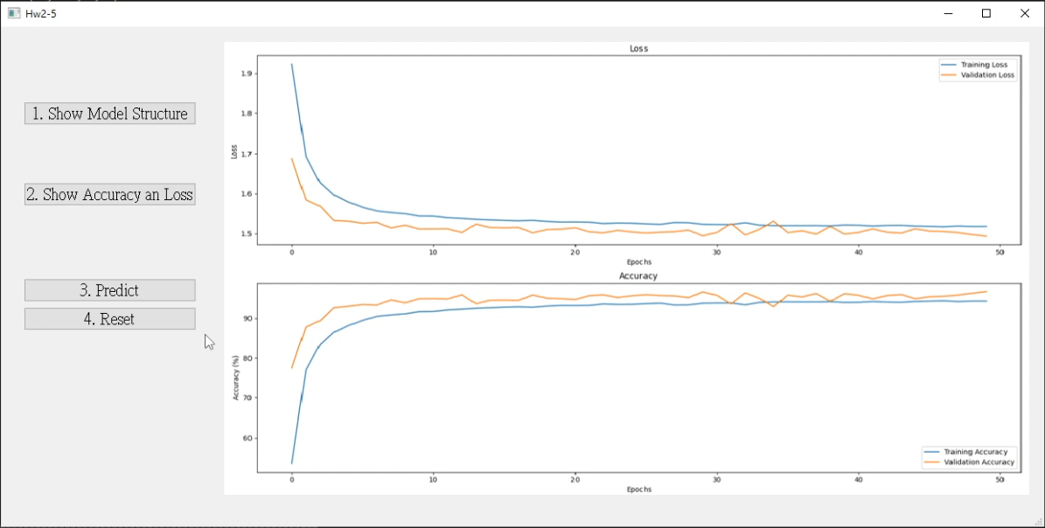
4.2 Show Training/Validating Accuracy and Loss (6%)
At home:
Download the training and validation datasets. (tutorial)
Training and validating VGG19 with BN at least 30 epochs at home (tutorial) and record the training/validating accuracy and loss in each epoch (tutorial).
If your validation accuracy is low, you can try
Adjust the learning rate of the optimizer.
Change the data augmentation techniques used.
Save weight file with highest validation accuracy .
Use matplotlib.pyplot.plot() to create a line chart for the training and validating loss and accuracy values and save the figure.
When the demo:
Click the button “2. Show Accuracy and Loss”
Show the saved figure of Training/Validating loss and accuracy in a new window
(出題：Shang)
(2) Show the figure in a new window
(1) Click the button.
Notice: this is an example, the number of epoch might differ

Slide 21
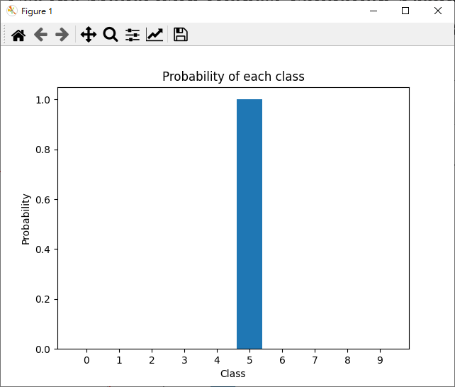
4.3 Use the Model with Highest Validation Accuracy to Run Inference, Show the Predicted Distribution and Class Label. (8%)
(出題：Shang)
Load the model with highest validation accuracy which trained at home.
Draw a number on graffiti board using mouse. (tutorial)
Background: black
Pen: white
Click the button “3. Predict” to run inference on the image you drew.
Show the predicted class label on the GUI.
Show the probability distribution of model predictions using a histogram in a new window.
Click the button “4. reset” to clear the graffiti board.
2.
3. Probability of each class
3.
4.
3. Predicted class

Slide 22

4.3 Use the Model with Highest Validation Accuracy to Run Inference, Show the Predicted Distribution and Class Label. (6%)
(出題：Shang)
The probability distribution of model prediction using a histogram.
Y-axis: probability
X-axis: class name

Slide 23
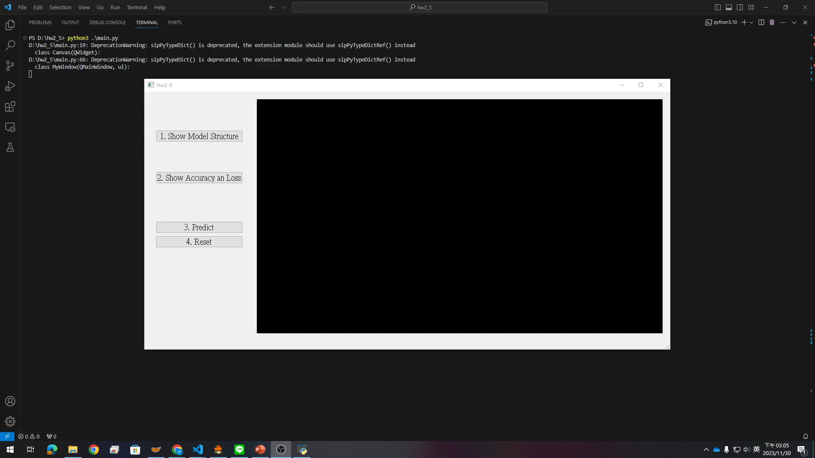
4. Training a MNIST Classifier Using VGG19 – Example Video
(出題：Shang)
This is an example illustrating the objectives from 4.1 ~ 4.3.

Slide 24
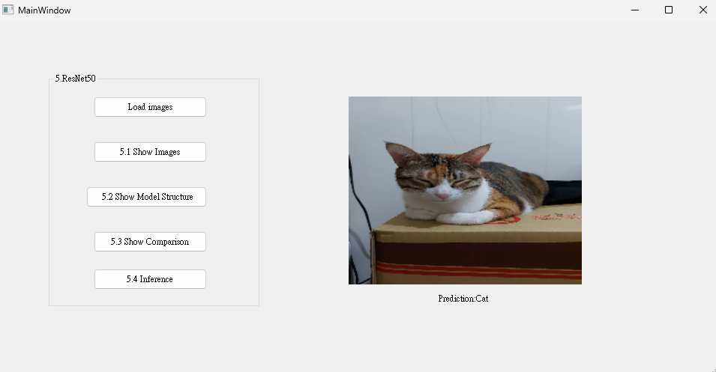
5. Train a Cat-Dog Classifier Using ResNet50 (20%)
(出題：Shan)
5.1 (5%) Load the dataset and resize images
5.2 (5%) Show the structure of ResNet50 model
5.3 (5%) Improve ResNet50 with Random-Erasing and Compare the accuracies of 2 ResNet50 models on validation dataset
5.4 (5%) Use the trained model to run inference and show the predicted class label
Figure: GUI Example

Slide 25
Objective
Learn how to train a ResNet50 model to classify images of cats and dogs using PyTorch (tutorial)
Download Cats and Dogs Dataset from FTP
Data type: JPG images
2 classes: Cat and Dog
Datasets
Training dataset: 16,200 JPG images in total.
Validation dataset: 1,800 JPG images in total.
Inference dataset: 10 JPG images in total. It is for testing the inference function in your GUI program.
5.0 Train a Cat-Dog Classifier Using ResNet50
(出題： Shan)
3. In the submitted file
Organize the files in this structure:
Hw2_StudentID_Name_Version // project folder
|-- model // folder to put trained models
|-- inference_dataset
|-- Cat
|-- Dog
|-- main.py // codes for your GUI program
|-- train.py // codes for model training
|-- ⁞ // other files or folders you need
Notice: Please include the inference dataset in your homework file.
R. Reference
Deep Residual Learning for Image Recognition
Kaggle Cats and Dogs Dataset

Slide 26
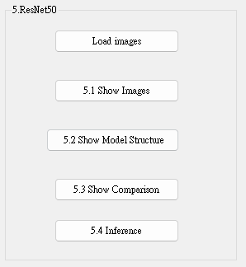
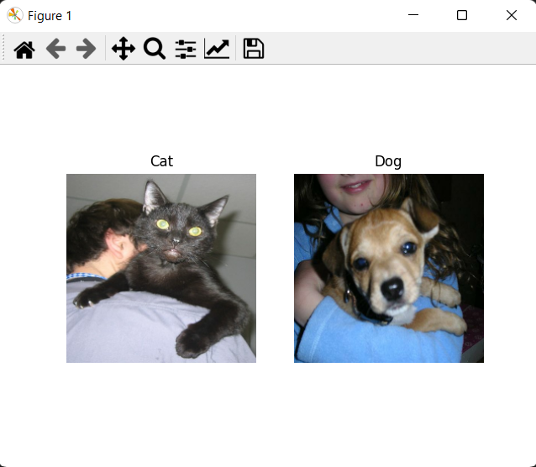
5.1 (5%) Load the dataset and resize images
(出題： Shan)
At home:
Load the training dataset and validation dataset
→ Hint:
(a) PyTorch (tutorial): torch.utils.data.Dataset
Resize images to 224×224×3c (RGB)
→ Hint:
(a) PyTorch (tutorial): torchvision.transform
(3) Click the button “1. Show Images”
(4) Load the inference dataset
(5) Resize images to 224×224×3c (RGB)
(6) Get 1 image from each class in the inference dataset
(7) Show images in a new window
→ Hint: use matplotlib.pyplot functions to show images (tutorial):
(a) figure()
(b) imshow()
(c) subplot()
(d) title()
When the demo:
Click the button “1. Show Images”
Show images in a new window
Figure: 1 image from each class
Notice: this is an example, the images might differ

Slide 27
5.2 (5%) Show the structure of ResNet50 model
(出題： Shan)
At home:
Build a ResNet50 model
→ Hint:
(a) PyTorch: torchvision.models.resnet50()
Replace the output layer to a FC (Fully Connected) layer of 1 node with a Sigmoid activation function
→ Hint:
(a) PyTorch (tutorial): torch.nn.Linear(2048, 1), torch.nn.Sigmoid
If the class label of Cat is 1, the output value (range: 0 ~ 1) should be close to 1 for cat images, and vice versa.
Run the function to show the structure in the terminal
→ Hint:
(a) PyTorch: torchsummary
When the demo:
Click the button “3. Show Model Structure”
Run the function to show the structure in the terminal

Slide 28
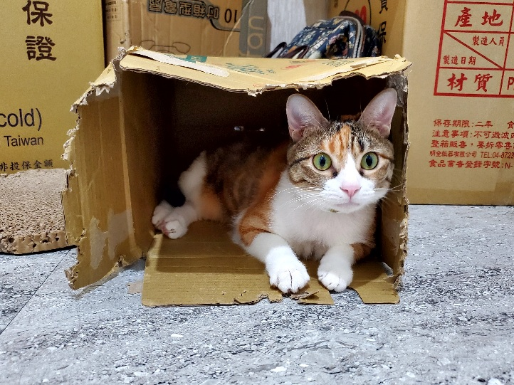
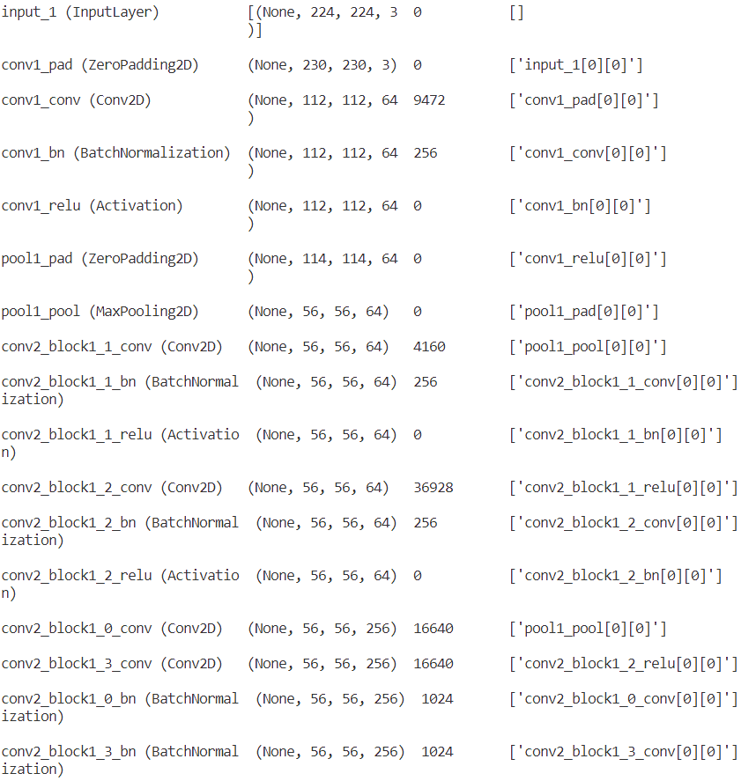
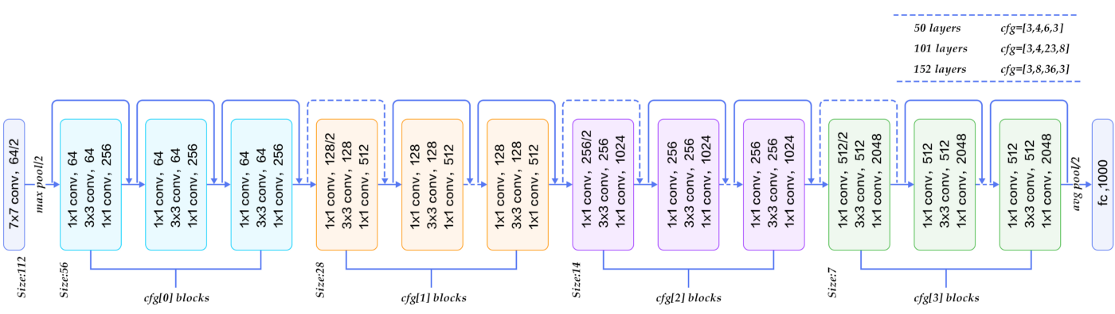
5.2 (5%) Show the structure of ResNet50 model
(出題： Shan)
Input: an RGB image 224×224×3c
Feature map shape
(B, H, W, C)
Num. of param.
Layer (type)
Layer connecting to
112×112×64c
3×3
/2: stride = 2
56×56×256c
×3
Every conv layer is followed by a BN layer and a ReLU layer
28×28×512c
×3
BN: Batch Normalization
ReLU: Rectified Linear Unit
×5
14×14×1024c
×2
7×7×2048c
global avg pool
FC, 1c
FC: fully connected
Figure: the structure of ResNet50 model
Output: a confidence value (range: 0 ~ 1)

Slide 29
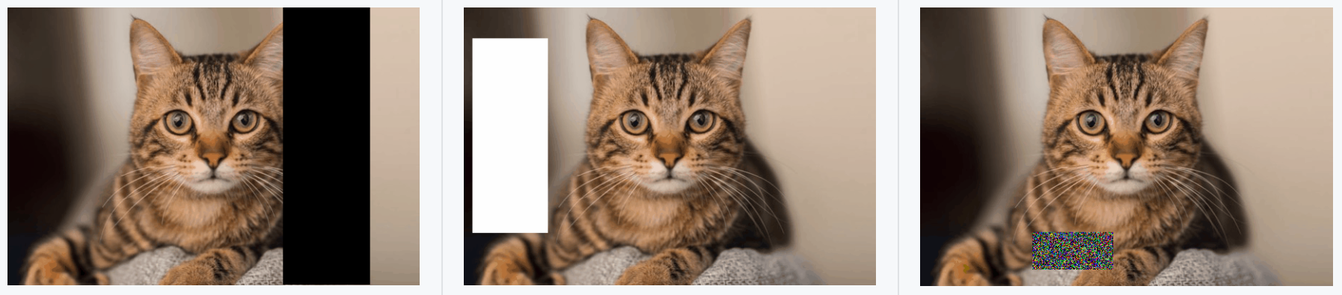
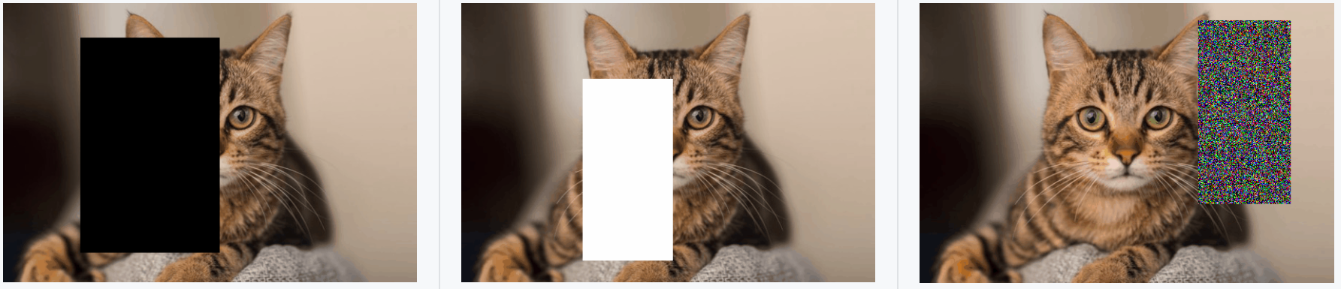
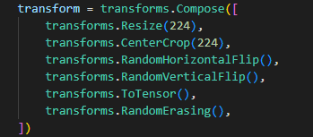
5.3 (5%) Improve ResNet50 with Random-Erasing
(出題： Shan)
At home: Set up Random-Erasing in codes for model training (train.py)
Train 2 ResNet50 models with training dataset
→ Hint:(a) PyTorch (tutorial): write a for loop to validate the model
(a) With Random-Erasing
(b) Without Random-Erasing
2) When the demo: Show your codes about Random-Erasing in train.py
Figure1: Examples of the use of Random-Erasing
R. Reference
Random Erasing Data Augmentation

Slide 30
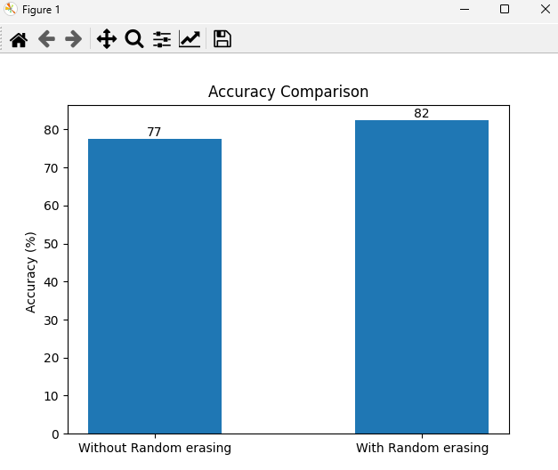
5.3 (5%) Compare the accuracies of 2 ResNet50 models on validation dataset
(出題： Shan)
At home:
Validate 2 ResNet50 models with validation dataset
→ Hint:
(a) PyTorch (tutorial): write a for loop to validate the model
Plot the accuracy values with a bar chart
Save the figure
When the demo:
Click the button “4. Show Comparison”
Show the saved figure of accuracy comparison in a new window
Figure1: Accuracy Comparison
Notice: this is an example, the numbers might differ

Slide 31
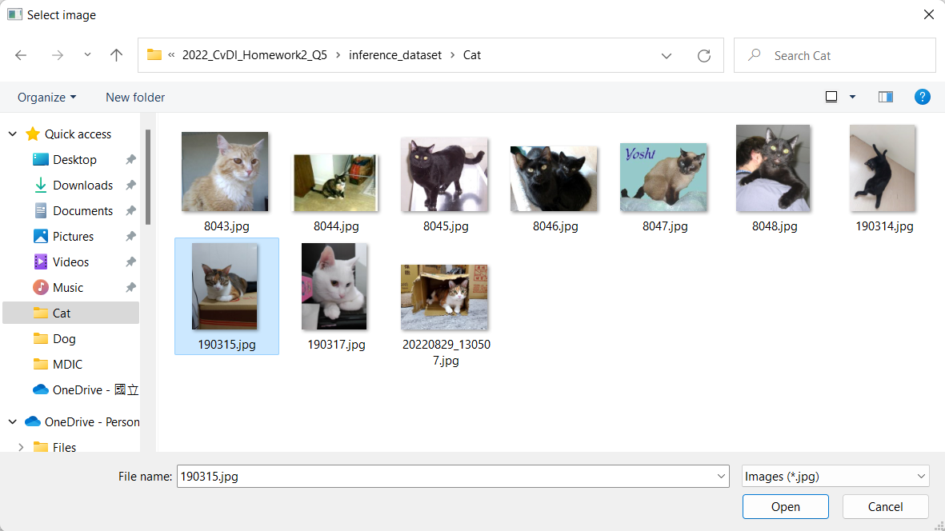
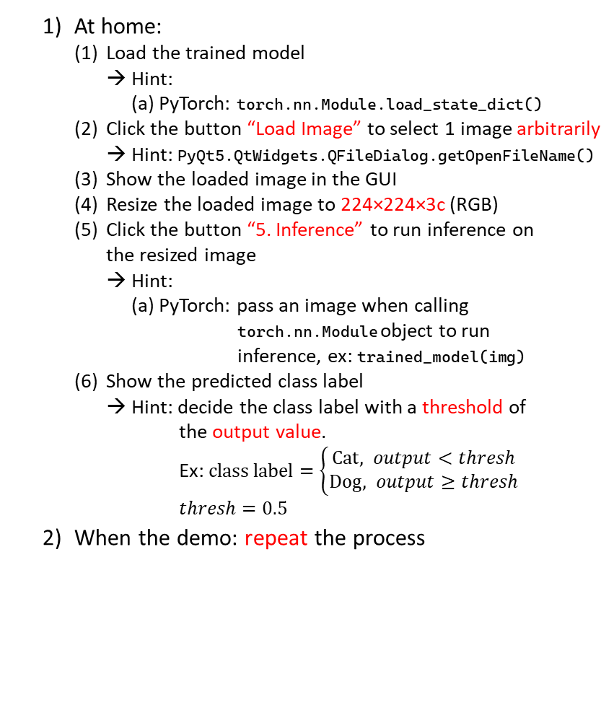
5.4 (5%) Use the better-trained model to run inference and show the predicted class label
(出題： Shan)
At home:
Load the trained model
→ Hint:
(a) PyTorch: torch.nn.Module.load_state_dict()
Click the button “Load Image” to select 1 image arbitrarily
→ Hint: PyQt5.QtWidgets.QFileDialog.getOpenFileName()
Show the loaded image in the GUI
Resize the loaded image to 224×224×3c (RGB)
Click the button “5. Inference” to run inference on the resized image
→ Hint:
(a) PyTorch: pass an image when calling torch.nn.Module object to run inference, ex: trained_model(img)
Show the predicted class label
→ Hint: decide the class label with a threshold of the output value. Ex: $class label=\left\{\begin{aligned}Cat, output<thresh \\ &Dog, output≥thresh\end{aligned}\right.$
$$thresh=0.5$$
When the demo: repeat the process
(2) Select 1 image arbitrarily
(3) Show the loaded image
(4) Resize the loaded image to 224×224×3c
(1) Click the button
(5) Run inference on the loaded image
(6) Show the predicted class label

Slide 32
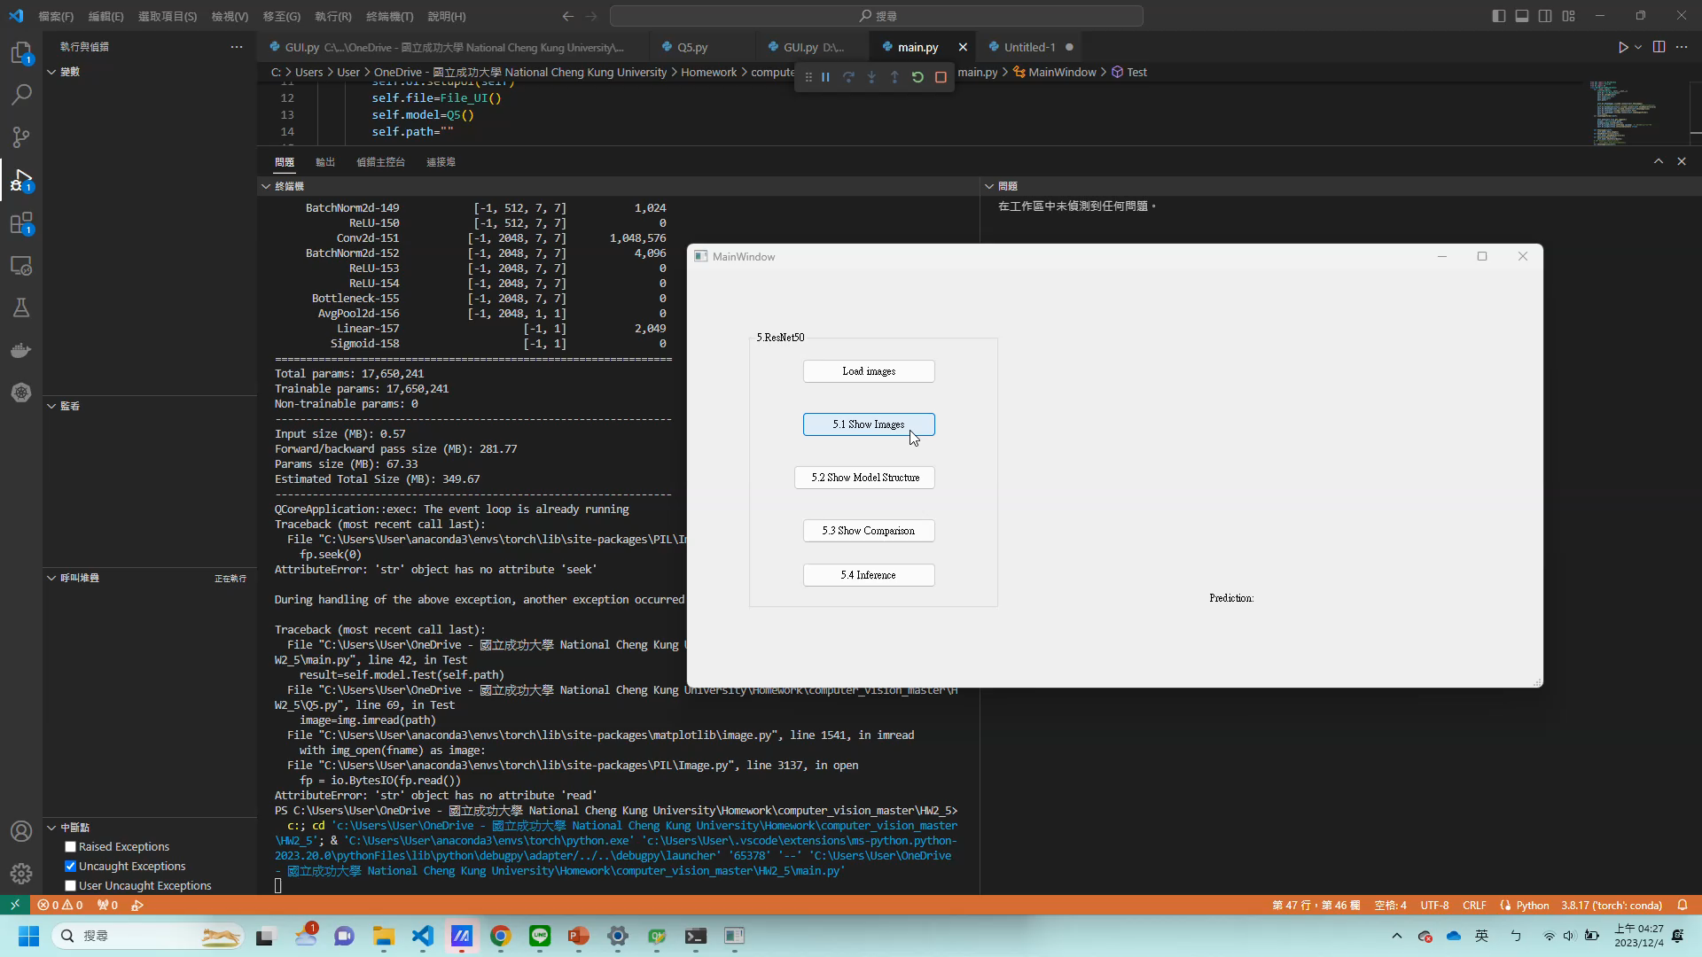
5. Train a Cat-Dog Classifier Using ResNet50 – Demo Video
This is an example illustrating the objectives from 5.1 ~ 5..

